Slide 1


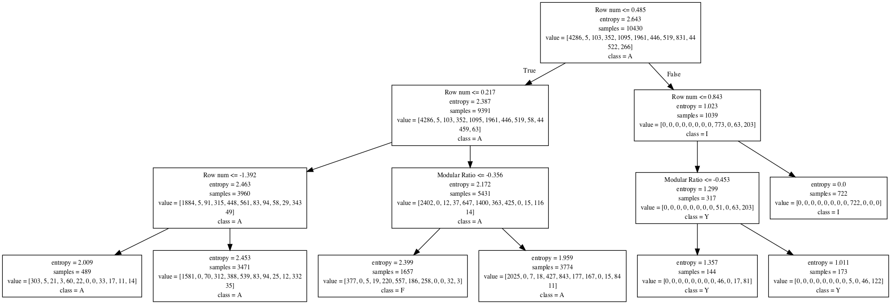
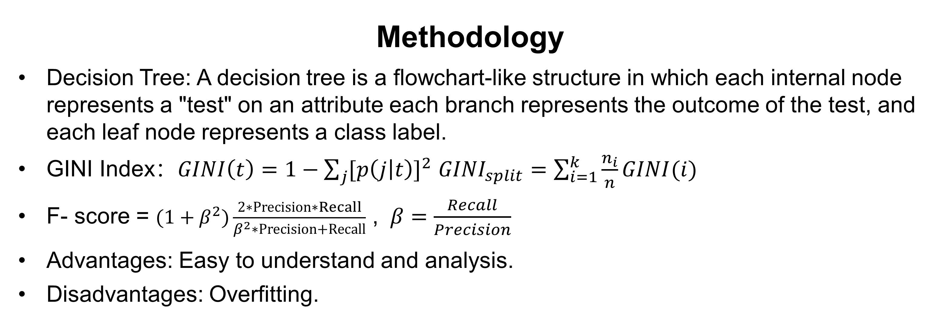
Identify copyist of “Avila Bible” with Decision Tree
Yiqin Huang (yh4bf)
Department of Statistics, University of Virginia
Master Final Exam 2019
Abstract
This project uses the data extracted from 800 images of the “Avila Bible”, a giant Latin copy of the whole Bible produced during the XII century between Italy and Spain.
The main goal of the project is to predict who is the copyist of the given a part of content.
The Decision Tree model is used to conduct the analysis and prediction.
Exploratory Data Analysis
Variables Distribution Visualization
Data Manipulation
Variables Correlation Matrix Plot
Discussion
The decision tree model gives a good prediction performance on the copyist identification problem by using the features extracted from the texts. If the depth of the tree is too large, the model may meet overfitting problem. Tune the model and choose both efficient and effective model is necessary.
The row number variable is the first node in the decision tree, which means that this feature is generally the most important for the copyist classification.
Strengths:
The decision tree model is well-suited for the multi-class classification problem.
The model complexity can be controlled by max depth of the decision tree.
Generated Tree can be easy to understand and analysis.
Large scale dataset is suitable.
Limitations:
Easy to be overfitting.
Information entropy may have some bias.
Further ensemble models(Random Forests Model, XGBoosts model) always perform better than single tree-oriented model.
Figure 2. 157 outliers
Background
The pages of “Avila Bible” written by each copyist are not equally numerous.
Each pattern contains 10 features corresponding to 4 consecutive rows.
The prediction task consists in associating each pattern to one of the 12 copyists(A, B, C, D, E, F, G, H, I, W, X, Y).
Methodology
Decision Tree: A decision tree is a flowchart-like structure in which each internal node represents a "test" on an attribute each branch represents the outcome of the test, and each leaf node represents a class label.
GINI Index：$GINI\left(t\right)=1−\sum_{j}{{[p\left(j | t\right)]}^{2}}$ ${GINI}_{split}=\sum_{i=1}^{k}{\frac{n_{i}}{n}GINI(i)}$
F- score = $(1+β^{2})\frac{2∗Precision∗Recall}{β^{2}∗Precision+Recall}$ , $β=\frac{Recall}{Precision}$
Advantages: Easy to understand and analysis.
Disadvantages: Overfitting.
Figure 1.
Figure3.
Data Description
The training set containing 10,430 samples, and a test set containing 10,437 samples.
There is no missing data.
1 response variable and 10 features.
Class distribution(training data set):
Variables:
Intercolumnar distance: distance between columns
Upper margin: upside value
Lower margin: downside value
Exploitation: column exploitation coefficient (the number of black pixels/the total number of pixels in the column)
Row number: number of rows in the column
Modular ratio: estimates the dimension of handwriting characters
Interlinear spacing: the distance in pixels between two rows
Weight: a measure of how much a row is filled with ink
modular ratio/ interlinear spacing
Peak number: the number of peaks in the horizontal projection histogram of rows
Data source: C.De Stefano(2018), UCI Machine Learning Repository [http://archive.ics.uci.edu/ml]. Irvine, CA: University of California, School of Information and Computer
Results
The train and test accuracy increase with the max depth of decision tree increases. But when depth is larger than 10, the influence on the test accuracy is very small.
We choose the max depth=14 of the decision tree for the final model.
The final average F-score is 0.97. Row number is the most significant feature.
Implication and future research
Implications:
The rank of features in terms of the importance.
The hyperparameters such as max depth of the decision tree is important for the final performance of the model.
The significant features are row numbers, exploration, and modular ratio/ interlinear spacing. These features are most representative and can better express the writing habits of the different copyist.
Future Study:
Other model such as Random Forests, Logistic Regression can be used and compared with the current Decision Tree model.
Feature Engineering can be used to further enhance the model performance. .
A | B | C | D | E | F | G | H | I | W | X | Y
4286 | 5 | 103 | 352 | 1095 | 1961 | 446 | 519 | 831 | 44 | 522 | 266
Figure 4.
Figure 5.
A | B | C | D | E | F | G | H | I | W | X | Y
0.98 | 1.00 | 0.96 | 0.96 | 0.95 | 0.98 | 0.98 | 0.95 | 0.98 | 0.93 | 0.93 | 0.95

